Slide 1
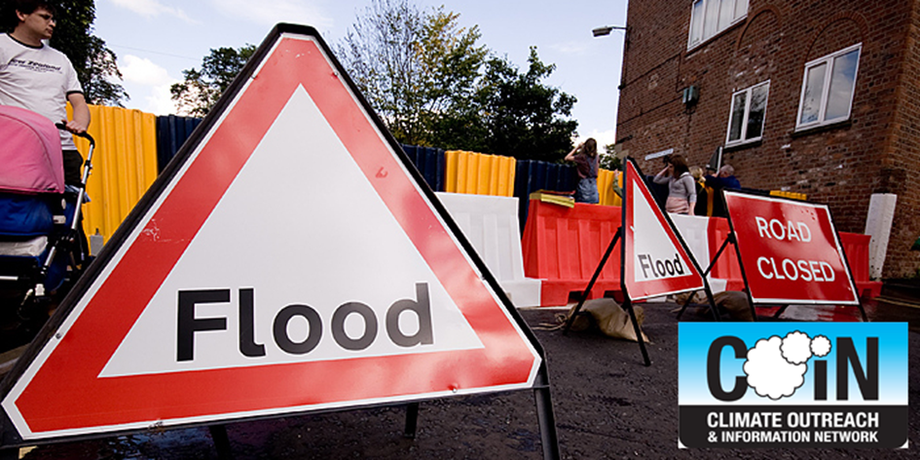
Flooding & Climate Change

Slide 2
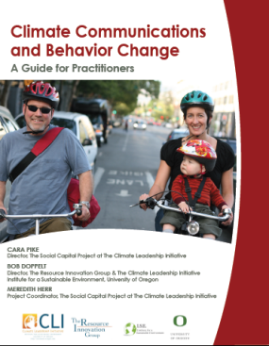
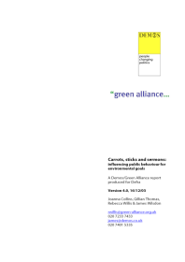
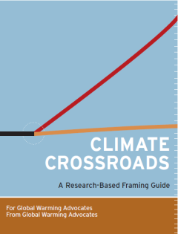
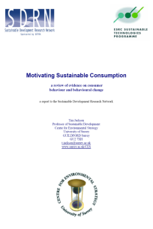
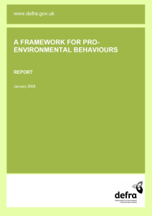
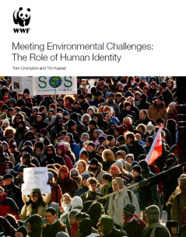

Slide 3
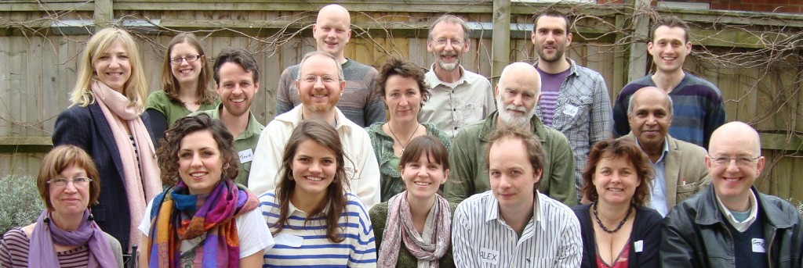
The COIN Team

Slide 4
Workshop Format
UK experience with flooding
Communities experience with flooding
Talking with others about climate change
Planning
Next steps

Slide 7
Notes:
Devon – train line to Devon

Slide 9
Talybont
Video 1
A video is shown of flooding in Talybont. This can be viewed on the COIN website.

Slide 10
-

Slide 11
Discussion
What your thoughts, your reactions to this video about Talybont’s experience?
How does this video relate to what you’ve experienced here?

Slide 12
Flooded community
Video 1
Discussions about the community the workshop is being held

Slide 13
Mitigation & Adaptation

Slide 14
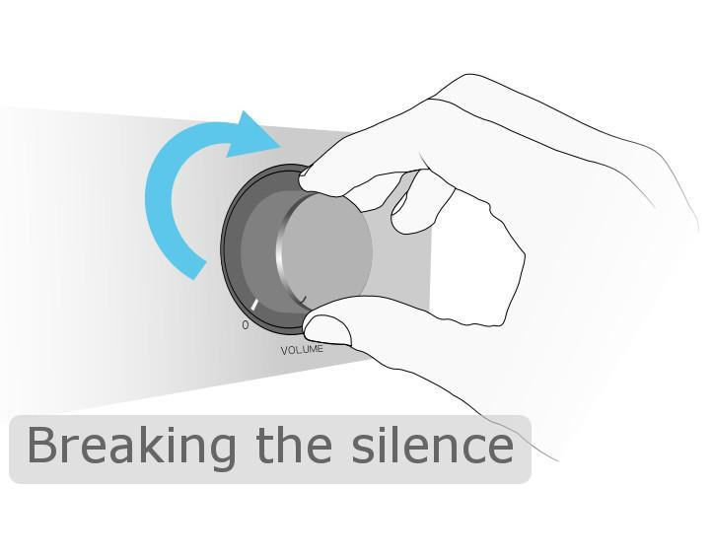

Slide 15
Notes:
Carbon Brief – january-feb 2014

Slide 16
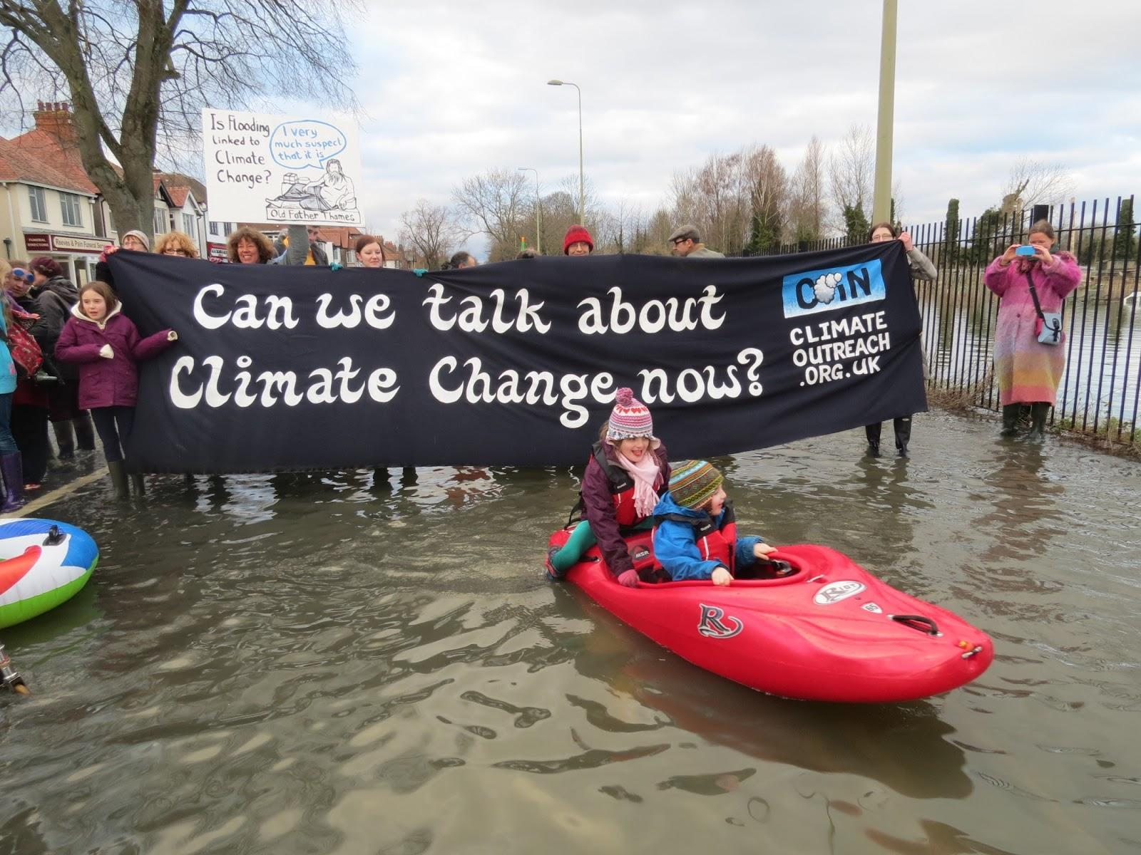
Image

Slide 17
Oxford
Video 1
A short video of people’s experience of flooding in Oxford and their thoughts on Climate Change is shown. Available to view on the COIN website.

Slide 18
Why climate change can be hard to talk about
Unpleasant experiences
Is technical
Seems distant
Has poor relevance
Hasn’t a strong story line
Is filtered by our world views

Slide 20
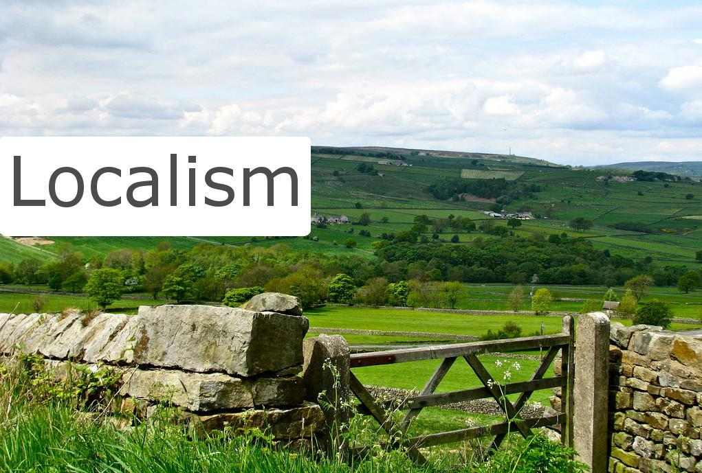

Slide 22
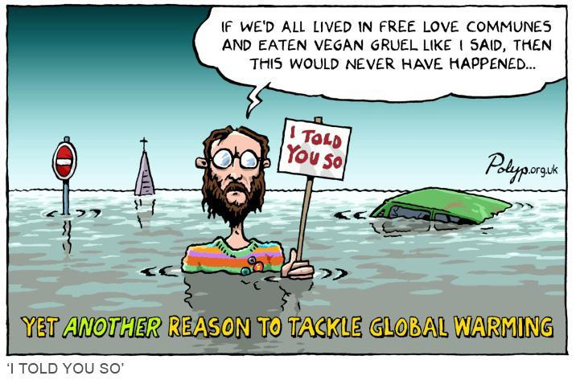

Slide 23
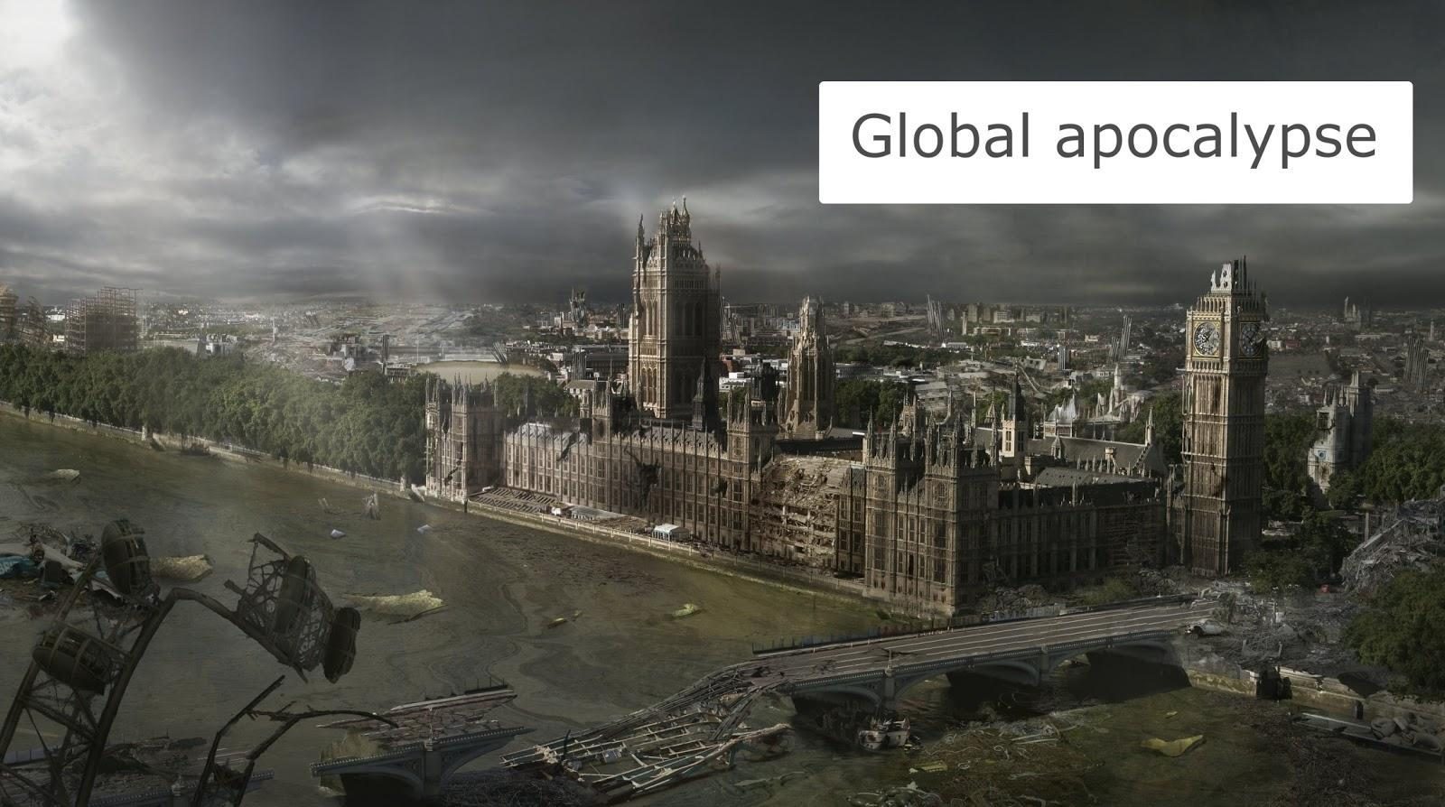

Slide 24
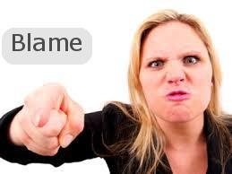

Slide 25
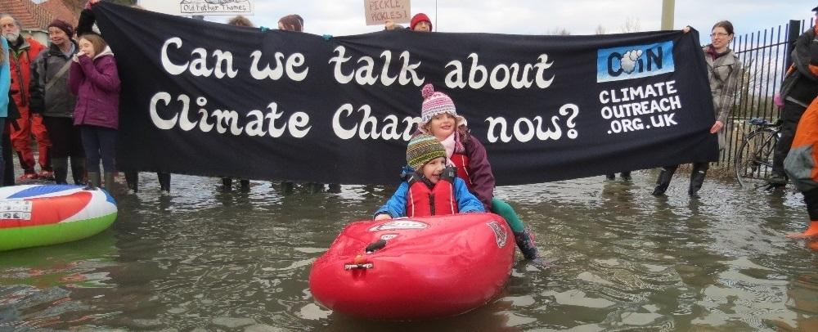
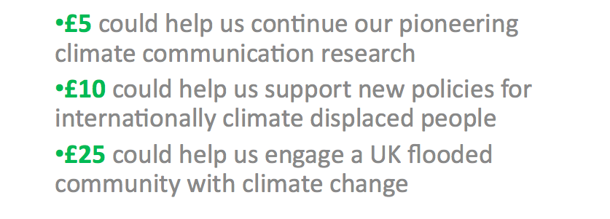
£5 could help us continue our pioneering climate communication research
£10 could help us support new policies for internationally climate displaced people
£25 could help us engage a UK flooded community with climate change

Slide 28
EWEs like floods can help build personal acceptance of climate change….
Fulfils the predictions of climate science
Provides a sign of things to come
Offers many of the story qualities that climate change lacks
Speaks to real experience
Is certain

Slide 29
…. but not necessarily
People interpret EWEs In the light of their existing attitudes to climate change
Strong reasons for NOT wishing to accept that such events might become stronger and more frequent
People and communities focused on recovery, on immediate present
Strong feelings of anger, blame, grief – communicators need to understand this

Slide 31
Next steps?
How does/can this connect to the activities you are already engaged in? and to what you are interested in doing?
Working with / building on flood plan that has been written? Actions for adaptation and mitigation?
Other discussion points?

